Slide 1
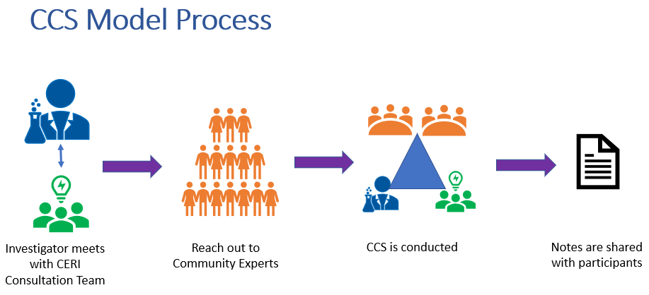
Community Consultation Studios (CCS)
Intent
To bring together academic researchers and community members to improve community health and healthcare through enhanced and informed research by increasing the researcher’s understanding and sensitivity of the community, and creates an awareness of community and patient priorities, values and needs
How is it Measured (mixed method approach)
Logic model, community baseline surveys, and evaluations that include open ended questions completed by both community members and the research teams.
We have a strong demand for CCCs leading to the completion 74 CCS within 4 years.
“I would participate in a virtual CCS again. I enjoy knowing about research that is being conducting in the community and it is great to have an opportunity to share personal feedback with researchers.” ~Community Participant
“I was really pleased with the quality of the organization and the feedback I received. I substantially changed my project to address patients needs more precisely” ~Researcher
Impact
>10 Letters of support written with the intent of a CCS
Emphasis on Return of Results to Durham and surrounding communities
Informs research implementation strategies to be inclusive of all communities.
Affirms the need for diverse participant recruitment strategies.
Advocate for community partnerships and practices to enhance CEnR.
Notes:
Tell the story of how HEAL came to be established 2016 – Built on Faith and Leadership, Engaging, partnering with the Community, Applying Health Equity framework, to create bi-directional relationships and trainings with researchers and communities to influence health outcomes for minoritized communities.
Extension of Yale AME Zion Model
Together we created our vision and rationale, and logic model to inform engagement with researchers and communities to increase access to clinical research.

